Slide 1
SWITCHING

Slide 2
Differentiate between a Hub, Switch and Router
HUB - In a hub, a frame is passed along or "broadcast" to every one of its ports. It doesn't matter that the frame is only destined for one port. The hub has no way of distinguishing which port a frame should be sent to. (Physical Layer).
SWITCH - A switch is able to handle the data and knows the specific addresses to send the message. It can decide which computer is the message intended for and send the message directly to the right computer. The efficiency of switch has been greatly improved, thus providing a faster network speed. (Data Link Layer).

Slide 3
Differentiate between a Hub, Switch and Router
ROUTER - Router is actually a small computer that can be programmed to handle and route the network traffic. It usually connects at least two networks together, such as two LANs, two WANs or a LAN and its ISP network.
Routers can calculate the best route for sending data and communicate with each other by protocols.
Network Layer

Slide 4
Network Switching
In large networks, there can be multiple paths from sender to receiver.
The switching technique will decide the best route for data transmission.
The switching technique is used to connect the systems for making one-to-one communication.

Slide 5
Network Switching
Switches are devices capable of creating temporary connections between two or more devices linked to the switch.
In a switched network some of these nodes are connected to the end systems. Others are used only for routing.

Slide 6
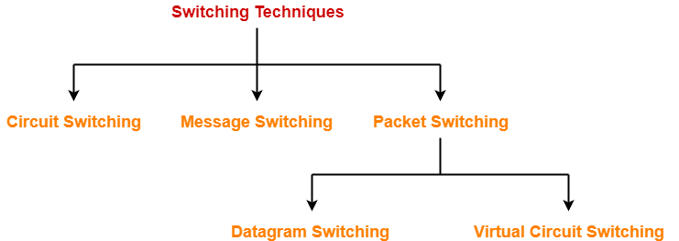
Methods of switching
Traditionally, there are three methods of switching,
  Circuit switching
  Packet switching
  Message switching

Slide 7
Switching in TCP/IP Layers
Switching can happen at several layers in TCP/IP.
Switching at Physical Layer:
  Only circuit switching
  No packets exchanged.
  The switches at the physical layer allow signals to travel in one path or another.
Switching at Data Link Layer:
  Packet switching
  Here packet means frames or cells.
  Packet switching in DLL normally done using the virtual-circuit approach.

Slide 8
Switching in TCP/IP Layers
Switching at Network Layer:
Packet switching.
Either a virtual-circuit approach or the Datagram approach can be used.
Currently, the internet uses a datagram approach.
Switching at Application Layer:
  Only have message switching.
  Communication at the application layer occurs by exchanging messages.

Slide 9
Circuit-Switched Networks
It consists of a set of switches connected by physical links.
A connection between two stations is a dedicated path between one or more links.
However, each connection uses only one dedicated channel on each link.
Each link is normally divided into “n” channels by using FDM or TDM.

Slide 10
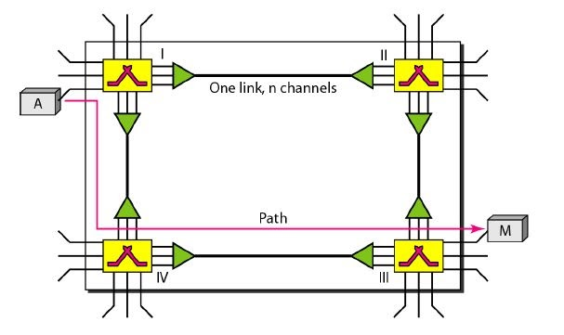
Circuit-Switched Networks
A circuit-switched network is made of a set of switches connected by physical links, in which each link is divided into ‘n’ channels.

Slide 11
Circuit-Switched Networks
The end systems, such as computers or telephones, are directly connected to a switch.
SETUP PHASE
----------------------
When the end system A needs to communicate with the end system M, system A needs to request a connection to M that must be accepted by all switches as well as by M itself.

Slide 12
Circuit-Switched Networks
The end systems, such as computers or telephones, are directly connected to a switch.
DATA TRANSFER PHASE
-----------------------------------
A circuit (channel) is reserved on each link and the combination of circuits or channels defines the dedicated path. After a dedicated path made of connected circuits (channels) is established, the DATA TRANSFER PHASE can take place.

Slide 13
Circuit-Switched Networks
The end systems, such as computers or telephones, are directly connected to a switch.
TEAR-DOWN PHASE
-----------------------------------
After all the data have been transferred, the circuits are torn down.

Slide 14
Circuit-Switched Networks
Circuit switching takes place at the physical layer.
Before starting the stations must make a reservation for the resources to be used during the communication. Resources include channels, switch buffers, switch processing time, and switch input/output ports. This reservation should be maintained until the teardown phase.
Data transferred are not packetized (The physical layer transfers signals).
There is no addressing involved during data transfer. There is end-to-end addressing used during the setup phase.

Slide 15
Efficiency and Delay
Efficiency:
Circuit-switched networks are not as efficient as the other two types of networks.
Resources are allocated during the entire duration of the connection.
These resources are unavailable to other connections.
Delay:
The delay in this type of network is minimal.
During data transfer, the data are not delayed at each switch.
The resources are allocated for the duration of the connection.

Slide 16
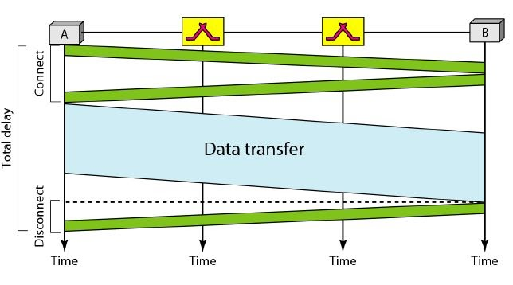
Delay
There is no waiting time for each switch.
The total delay is due to the time needed to create the connection, transfer data, and disconnect the circuit.

Slide 17
Packet Switching
The message needs to be divided into packets of fixed or variable size.
The size of the packet is determined by the network and the governing protocol.
In a packet-switched network, there is no resource allocation; resources are allocated on demand.

Slide 18
Packet Switching
In packet switching,
  No resource allocation for a packet.
  No reserved bandwidth on the links.
  No scheduled processing time for each packet.
  Resources are allocated on demand.
  Allocation is done on an FCFS basis.
  The received packet must wait if there are other packets being processed.
  The lack of reservations may create delays.

Slide 19
Packet Switching
We have two types of packet-switched networks:
Datagram Networks
Virtual-Circuit networks

Slide 20
Datagram Networks
Each packet is treated independently of all others.
Even if a packet is part of a multi-packet transmission the network treats it as though it existed alone.
Packets in this approach are referred to as datagrams.
Datagram switching is normally done at the network layer.

Slide 21
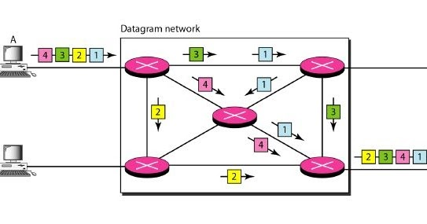
Datagram Networks
A datagram network with four switches is given below.

Slide 22
Datagram Networks
All four packets belong to the same message.
But , may travel different paths to reach their destination.
Arrives at their destination out of order.
Different delays for each packets.
Packets may also be lost or dropped because of the lack of resources.

Slide 23
Datagram Networks
The datagram networks are sometimes called connectionless networks.
The term connectionless here means that the switch does not keep information about the connection state.

Slide 24
Datagram Networks
Routing Table:
There are no setup or teardown phases.
The packets are routed to their destinations in a datagram network using routing tables.
Each switch has a routing table that is based on the destination address.
The routing tables are dynamic and are updated periodically.
The destination addresses and the corresponding forwarding output ports are recorded in the tables.

Slide 25
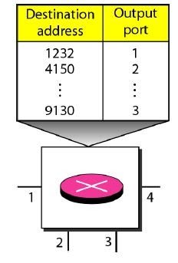
Datagram Networks: Routing Table
A switch in a datagram network uses a routing table that is based on the destination address.
Destination address:
  Every packet in a datagram network carries a header.
  Contains the destination address of the packet among other information.

Slide 26
Efficiency and Delay
The efficiency of a datagram network is better than that of a circuit-switched network;
Resources are allocated only when there are packets to be transferred.
If a source sends a packet and there is a delay of a few minutes before another packet can be sent, the resources can be reallocated during these minutes for other packets from other sources.

Slide 27
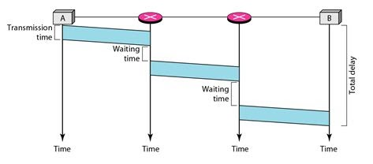
Efficiency and Delay
There may be a greater delay in the datagram network than in the virtual-circuit network.
There are no setup and tear-down phases.
Each packet may experience a wait at a switch before it is forwarded.
Total Delay = 3T + 3ꞇ + w₁ + w₂

Slide 28
Virtual-Circuit Networks
It is a cross between a circuit-switched network and a datagram network.
It has some characteristics of both.
  There are setup and teardown phases in addition to the data transfer phase.
  Resources can be allocated during the setup phase or on-demand.
  As in a datagram network, data is packetized and each packet carries an address in the header. The address in the header has local jurisdiction, not end-to-end jurisdiction.
  All packets follow the same path established during the connection.

Slide 29
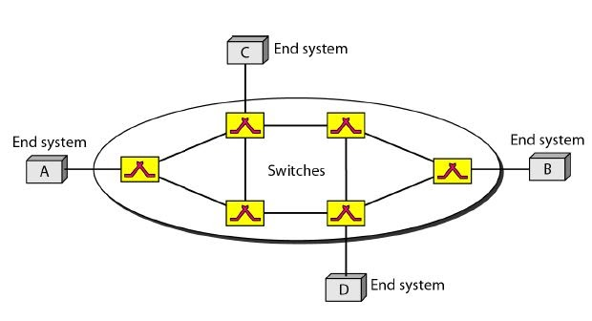
Virtual-Circuit Networks

Slide 30
Virtual-Circuit Networks
Addressing
  In a VC network, two types of addressing are involved:
    Global Addressing
    Local Addressing (Virtual-Circuit Identifier)

Slide 31
Virtual-Circuit Networks
Global Addressing:
A source or a destination needs to have a global address.
An address that can be unique in the scope of the network or internationally if the network is a part of an international network.
A global address in a virtual circuit network is used only to create a VCI.

Slide 32
Virtual-Circuit Networks
Virtual-Circuit Identifier:
The identifier that is actually used for data transfer is called the VCI or label.
Unlike a global address, VCI is a small number.
It has only a switch scope.
It is used by a frame between two switches.

Slide 33
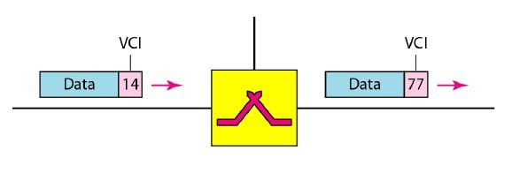
Virtual-Circuit Networks
When a frame arrives, it has a VCI; when it leaves it has a different VCI.

Slide 34
Virtual-Circuit Networks
Three Phases
  Setup Phase
  Data Transfer Phase
  Teardown Phase

Slide 35
Virtual-Circuit Networks
  Data Transfer Phase
--------------------------------------
To transfer a frame from a source to a destination, all switches need to have a table entry for this virtual unit.
It has four columns,.
i.e. a switch holds four pieces of information for each virtual circuit that is already set up.

Slide 36
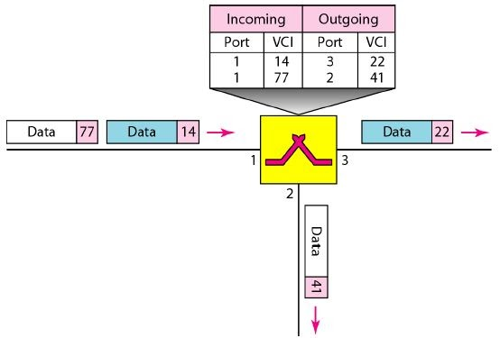
Virtual-Circuit Networks
  Data Transfer Phase
--------------------------------------
A switch and its corresponding table.

Slide 37
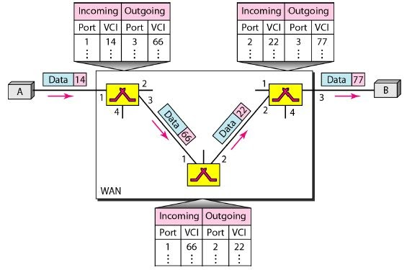
Virtual-Circuit Networks
  Data Transfer Phase
--------------------------------------
Source to Destination data transfer and how the VCI changes during the trip.

Slide 38
Virtual-Circuit Networks
  Setup Phase
--------------------------------------
Here, a switch creates an entry for a virtual circuit.
Suppose A wants to create a VC to B, two steps are required:
The setup request
The acknowledgment.

Slide 39
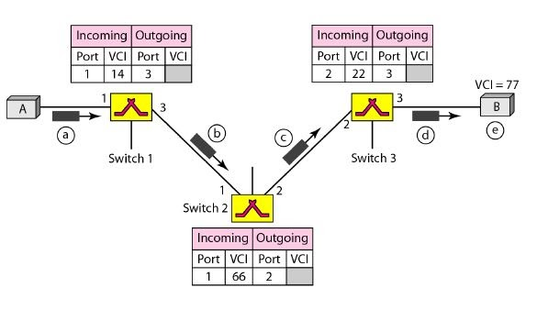
Virtual-Circuit Networks
  Setup Phase
--------------------------------------
Setup Request: A setup request frame is sent from the source to the destination.

Slide 40
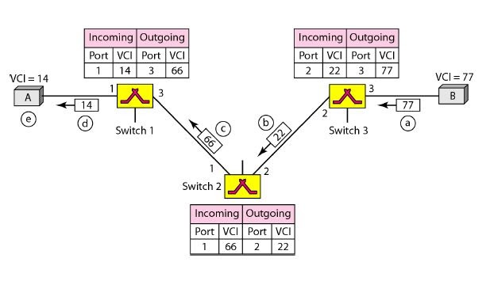
Virtual-Circuit Networks
  Setup Phase
--------------------------------------
Acknowledgment: A special frame called the acknowledgment frame, completes the entries in the switching table.

Slide 41
Virtual-Circuit Networks
  Efficiency
------------------------------------------
Resource reservation
On demand
Resource allocation is on demand.
The source can check the availability of the resources, without actually reserving it.

Slide 42
Virtual-Circuit Networks
  Efficiency
------------------------------------------
In virtual-circuit switching, all packets belonging to the same source and destination travel the same path, but the packets may arrive at the destination with different delays if resource allocation is on demand.

Slide 43
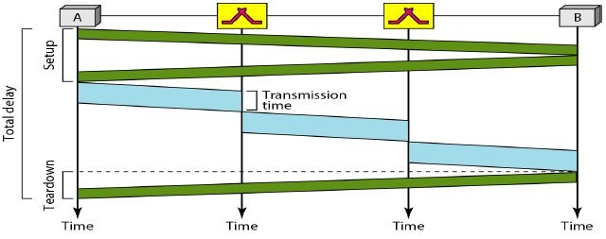
Virtual-Circuit Networks
  Delay
--------------------------------
Total Delay = 3T + 3τ + setup delay + teardown delay

Slide 44
Virtual-Circuit Networks
  Delay
--------------------------------
Total Delay = 3T + 3τ + setup delay + teardown delay

Slide 45
Structure of a Switch
Structure of Circuit Switches
Space-Division Switch
Time-Division Switch

Slide 46
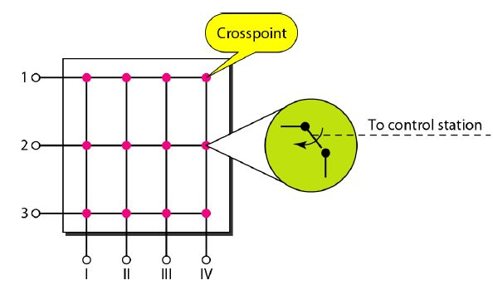
Structure of a Switch
Space-Division Switch
The paths in the circuit are separated from one another spatially.
It has evolved through a long history of many designs,
1. Crossbar Switch
A crossbar switch connects n inputs to m outputs in a grid, using electronic micro switches at each crosspoint.
The major limitation is number of crosspoints required.
To connect n inputs to m outputs using a crossbar switch requires n x m crosspoints.

Slide 47
Structure of a Switch
Space-Division Switch
1. Multistage Switch
The solution to the limitations of the crossbar switch is the multistage switch.
It combines crossbar switches in several (normally 3) stages.
In a single crossbar switch only one row or column (one path) is active for any connection. So we need N x N crosspoints.
If we can allow multiple paths inside the switch, we can decrease the number of crosspoints.
Each crosspoints in the middle stage can be accessed by multiple crosspoints in the first or third stage.

Slide 48
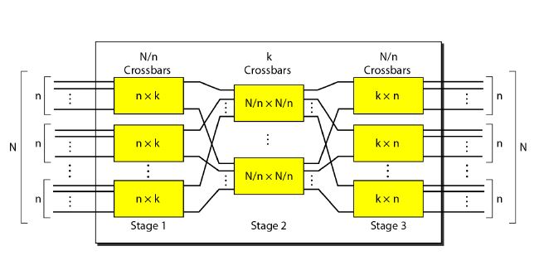
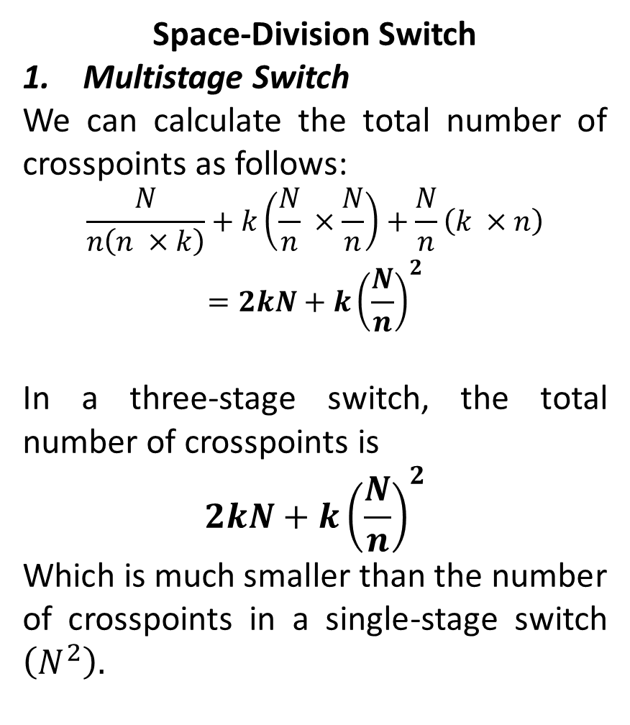
Structure of a Switch
Space-Division Switch
Multistage Switch
We can calculate the total number of crosspoints as follows:
$$\frac{N}{n\left(n ×k\right)}+k\left(\frac{N}{n} ×\frac{N}{n}\right)+\frac{N}{n}\left(k ×n\right)$$
$$=2kN+k{\left(\frac{N}{n}\right)}^{2}$$
In a three-stage switch, the total number of crosspoints is
$$2kN+k{\left(\frac{N}{n}\right)}^{2}$$
Which is much smaller than the number of crosspoints in a single-stage switch $\left(N^{2}\right).$

Slide 49
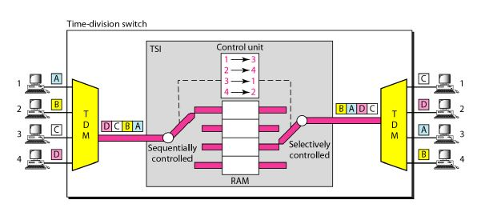
Structure of a Switch
Time-Division Switch
It uses TDM inside a switch.
The most popular technology is called time-slot interchange.
Time-Slot Interchange
A TDM Multiplexer
A TDM DE multiplexer
A TSI consisting of RAM with several memory locations.

Slide 50
Structure of a Switch
Structure of Packet switches
A packet switch has four components:
Input ports.
Output ports.
The Routing processor.
The Switching fabric.

